Slide 1
Computer Graphics

Slide 2
Unit III Clipping and Windowing
Polygon: Introduction, Types of the polygon, Representation of Polygon, Inside test
Polygon filling algorithms:
Windowing: Introduction, Viewport, Viewing transformation,
Clipping: 2D clipping, Polygon clipping

Slide 3
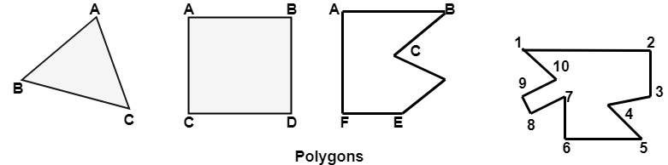
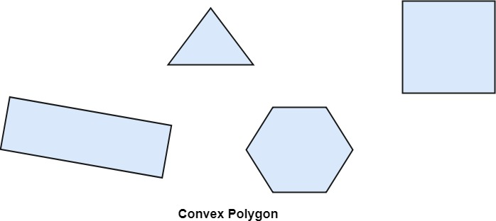
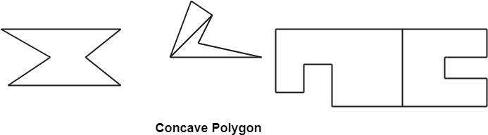
Polygon:
Polygon is a representation of the surface. It is primitive which is closed in
nature. It is formed using a collection of lines. It is also called as many-sided figure. The lines combined to form polygon are called sides or edges. The lines are obtained by combining two vertices.
Example of Polygon:
Triangle
Rectangle
Hexagon
Pentagon

Slide 4
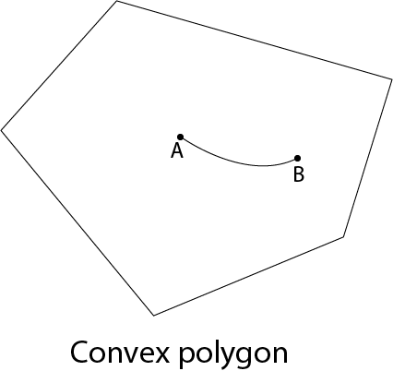
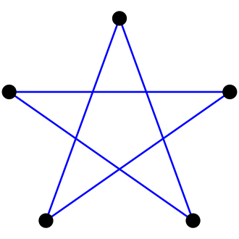
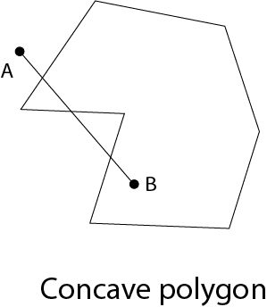
Types of Polygons
1) Convex
2)Concave
3) Complex
Complex Polygon

Slide 5
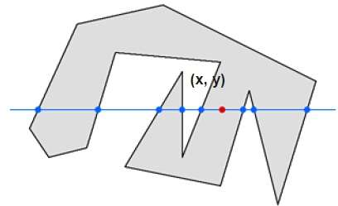
Inside-outside Test :
This method is also known as counting number method. While filling an object,
we often need to identify whether particular point is inside the object or outside it. There are two methods by which we can identify whether particular point is inside an object or outside.
1) Odd-Even Rule
2)Nonzero winding number rule
Odd-Even Rule
In this technique, we will count the edge crossing along the line from any point x,y to infinity. If the number of interactions is odd, then the point x,y is an interior point; and if the number of interactions is even, then the point x, y is an exterior point.

Slide 6
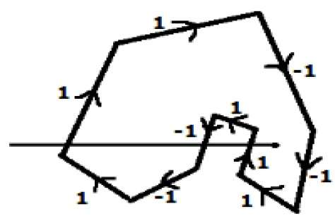
From the above figure, we can see that from the point x,y the number of
interactions point on the left side is 5 and on the right side is 3. From both ends, the number of interaction points is odd, so the point is considered within the object.
2)Nonzero winding number rule :
This method is also used with the simple polygons to test the given point is interior or not.

Slide 7
Give directions to all the edges of the polygon. Draw a scan line from the point to be test towards the left most of X direction.
* Give the value 1 to all the edges which are going to upward direction and all other -1 as direction values.
* Check the edge direction values from which the scan line is passing and sum up them.
* If the total sum of this direction value is non-zero, then this point to be tested is an interior point, otherwise it is an exterior point.
*In the above figure, we sum up the direction values from which the scan line is passing then the total is 1 – 1 + 1 = 1; which is non-zero. So the point is said to be an interior point.

Slide 8
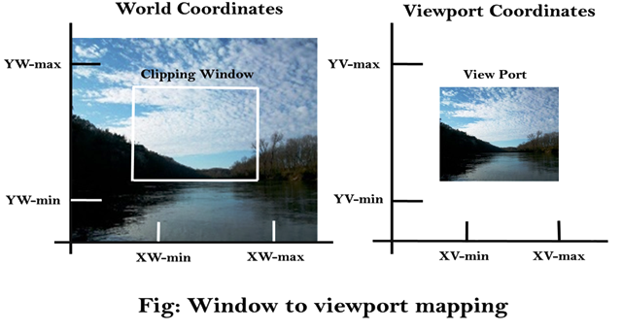
Windowing and clipping: Viewing transformations:
Viewing Transformation is the mapping of coordinates of points and lines that form the picture into appropriate coordinates on the display device.
World coordinate system (WCS) is the right handed cartesian co-ordinate system where we define the picture to be displayed. A finite region in the WCS is called the Window. The corresponding coordinate system on the display device where the image of the picture is displayed is called the physical coordinate system. Mapping the window onto a sub region of the display device called the viewport is called the Viewing Transformation.
Once object description has been
transmitted to the viewing reference frame,
we choose the window extends in viewing
coordinates and selects the viewport limits
in normalized coordinates.

Slide 9
Window to Viewport Transformation
The process of transforming 2D world-coordinate objects to device coordinates. Objects inside the world or clipping window are mapped to the viewport which is the area on the screen where world coordinates are mapped to be displayed.

Slide 10
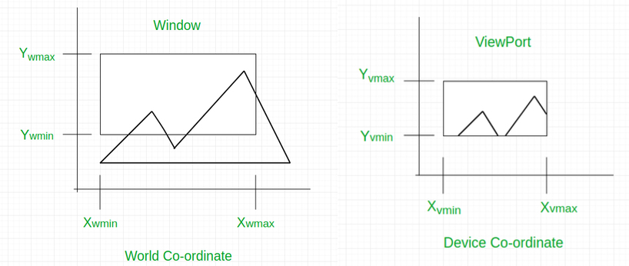

Slide 11
General Terms:
World coordinate – It is the Cartesian coordinate w.r.t which we define the diagram, like X_{wmin}, X_{wmax}, Y_{wmin}, Y_{wmax}
Device Coordinate –It is the screen coordinate where the objects are to be displayed, like X_{vmin}, X_{vmax}, Y_{vmin}, Y_{vmax}
Window –It is the area on the world coordinate selected for display.
ViewPort –It is the area on the device coordinate where graphics is to be displayed.

Slide 12
Mathematical Calculation of Window to Viewport:
It may be possible that the size of the Viewport is much smaller or greater than the Window. In these cases, we have to increase or decrease the size of the Window according to the Viewport and for this, we need some mathematical calculations.
(xw, yw): A point on Window
(xv, yv): Corresponding point on Viewport

Slide 13
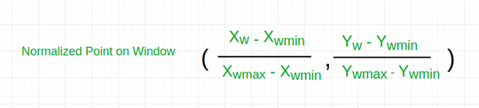
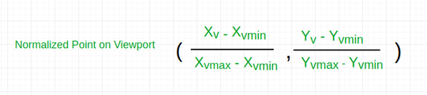
We have to calculate the point (x_{v}, y_{v})

Slide 14


Now the relative position of the object in Window and Viewport are same. For x coordinate,
For Y coordinate

Slide 15


So, after calculating for x and y coordinate, we get

Slide 16


Where s_{x} is the scaling factor of x coordinate and s_{y} is the scaling factor of y coordinate

Slide 17
Example: Let us assume,
for window, X_{wmin} = 20, X_{wmax} = 80, Y_{wmin} = 40, Y_{wmax} = 80.
for viewport, X_{vmin} = 30, X_{vmax} = 60, Y_{vmin} = 40, Y_{vmax} = 60.
Now a point ( X_{w}, Y_{w} ) be ( 30, 80 ) on the window. We have to calculate that point on the viewport i.e ( X_{v}, Y_{v} ).

Slide 18
First of all, calculate the scaling factor of x coordinate Sx and the scaling factor of y coordinate Sy using the above-mentioned formula.
Sx = ( 60 - 30 ) / ( 80 - 20 ) = 30 / 60
Sy = ( 60 - 40 ) / ( 80 - 40 ) = 20 / 40
So, now calculate the point on the viewport
( X_{v}, Y_{v} ).
Xv = 30 + ( 30 - 20 ) * ( 30 / 60 ) = 35
Yv = 40 + ( 80 - 40 ) * ( 20 / 40 ) = 60
So, the point on window ( X_{w}, Y_{w} ) = ( 30, 80 ) will be ( X_{v}, Y_{v} ) = ( 35, 60 ) on viewport.

Slide 19
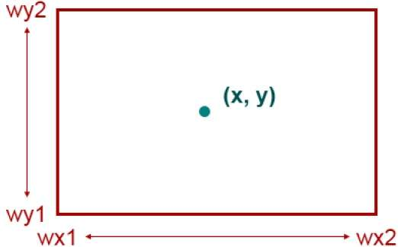
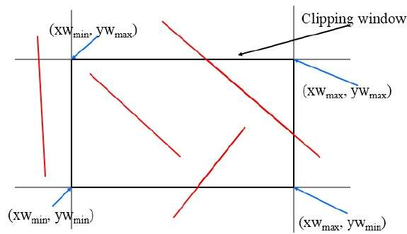
Clipping:
The primary use of clipping in computer graphics is to remove objects, lines,
or line segments that are outside the viewing pane. The viewing transformation is insensitive to the position of points relative to the viewing volume − especially those points behind the viewer and it is necessary to remove these points before generating the view.
Point Clipping
Polygon Clipping
Text Clipping
Line Clipping

Slide 20
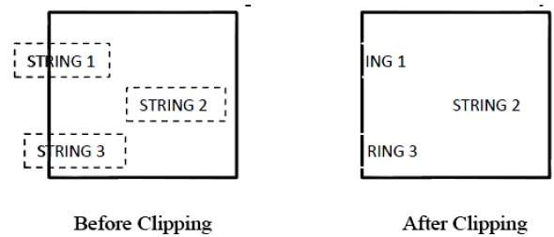
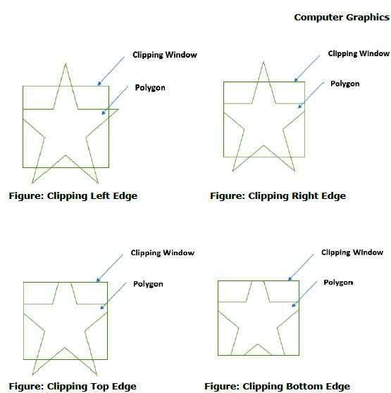
Clipping:

Slide 21
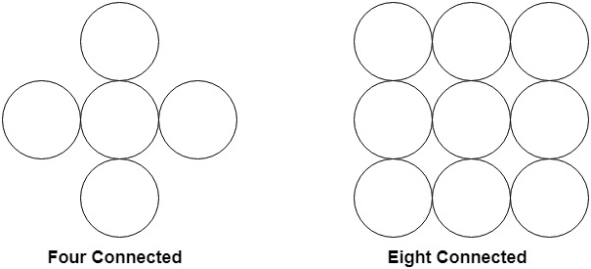
Polygon Filling Algorithm
Polygon is an ordered list of vertices as shown in the following figure.
For filling polygons with particular colors, you need to determine the pixels falling on the border of the polygon and those which fall inside the polygon. In this chapter, we will see how we can fill polygons using different techniques.
Boundary Filled Algorithm:
This algorithm uses the recursive method. First of all, a starting pixel called as the seed is considered. The algorithm checks boundary pixel or adjacent pixels are colored or not. If the adjacent pixel is already filled or colored then leave it, otherwise fill it. The filling is done using four connected or eight connected approaches.

Slide 22
Boundary Filled Algorithm:
This algorithm uses the recursive method. First of all, a starting pixel called as
the seed is considered. The algorithm checks boundary pixel or adjacent pixels are colored or not. If the adjacent pixel is already filled or colored then leave it, otherwise fill it. The filling is done using four connected or eight connected approaches.

Slide 23
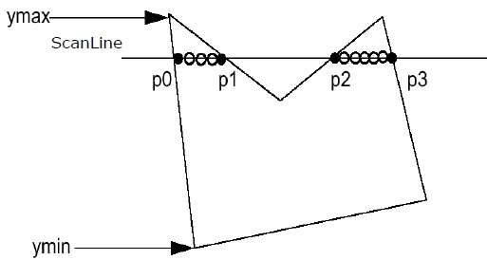
Polygon Filling Algorithm
Polygon is an ordered list of vertices as shown in the following figure. For filling polygons with particular colors, you need to determine the pixels falling on the border of the polygon and those which fall inside the polygon. In this chapter, we will see how we can fill polygons using different techniques.
Scan Line Algorithm
This algorithm works by intersecting scanline with polygon edges and fills the polygon between pairs of intersections. The following steps depict how this algorithm works.
Step 1 − Find out the Ymin and Ymax from the given polygon.
Step 2 − ScanLine intersects with each edge of the polygon from Ymin to Ymax. Name each intersection point of the polygon. As per the figure shown above, they are named as p0, p1, p2, p3.
Step 3 − Sort the intersection point in the increasing order of X coordinate i.e. p0,p1p0,p1, p1,p2p1,p2, and p2,p3p2,p3.
Step 4 − Fill all those pair of coordinates that are inside polygons and ignore the alternate pairs.

Slide 24
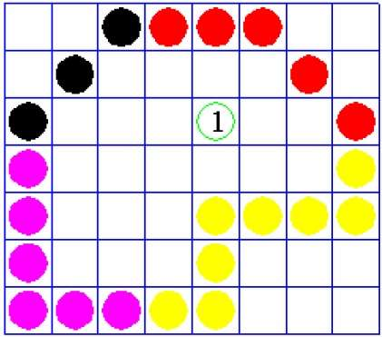
Polygon Filling Algorithm
Flood Fill Algorithm :
Sometimes we come across an object where we want to fill the area and its boundary with different colors. We can paint such objects with a specified interior color instead of searching for particular boundary color as in boundary filling algorithm.
Instead of relying on the boundary of the object, it relies on the fill color. In other words, it replaces the interior color of the object with the fill color. When no more pixels of the original interior color exist, the algorithm is completed.
Once again, this algorithm relies on the Four-connect or Eight-connect method of filling in the pixels. But instead of looking for the boundary color, it is looking for all adjacent pixels that are a part of the interior.

Slide 25
Windowing and 2D clipping
The primary use of clipping in computer graphics is to remove objects, lines, or line segments that are outside the viewing pane. The viewing transformation is insensitive to the position of points relative to the viewing volume − especially those points behind the viewer − and it is necessary to remove these points before generating the view.
Point Clipping
Clipping a point from a given window is very easy. Consider the following figure, where the rectangle indicates the window. Point clipping tells us whether the given point X,YX,Y is within the given window or not; and decides whether we will use the minimum and maximum coordinates of the window.
The X-coordinate of the given point is inside the window, if X lies in between Wx1 ≤ X ≤ Wx2. Same way, Y coordinate of the given point is inside the window, if Y lies in between Wy1 ≤ Y ≤ Wy2.
Line Clipping
The concept of line clipping is same as point clipping. In line clipping, we will cut the portion of line which is outside of window and keep only the portion that is inside the window.

Slide 26
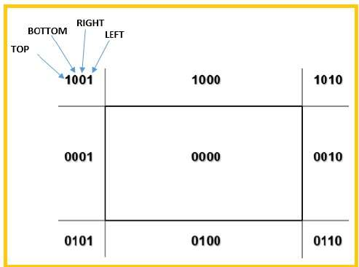
Cohen-Sutherland Line Clippings
This algorithm uses the clipping window as shown in the following figure.
The minimum coordinate for the clipping region is (XWmin,YWmin)(XWmin,YWmin) and the maximum coordinate for the clipping region is (XWmax,YWmax)
We will use 4-bits to divide the entire region.
These 4 bits represent the Top, Bottom, Right,
and Left of the region as shown in the following
figure. Here, the TOP and LEFT bit is
set to 1 because it is the TOP-LEFT corner.

Slide 27
Cohen-Sutherland Line Clippings
Algorithm
Step 1 − Assign a region code for each endpoints.
Step 2 − If both endpoints have a region code 0000 then accept this line.
Step 3 − Else, perform the logical AND operation for both region codes.
Step 3.1 − If the result is not 0000, then reject the line.
Step 3.2 − Else you need clipping.
Step 3.2.1 − Choose an endpoint of the line that is outside the window.
Step 3.2.2 − Find the intersection point at the window boundary base on region code base on region code.
Step 3.2.3 − Replace endpoint with the intersection point and update the region code.
Step 3.2.4 − Repeat step 2 until we find a clipped line either trivially accepted or trivially rejected.
Step 4 − Repeat step 1 for other lines.

Slide 28
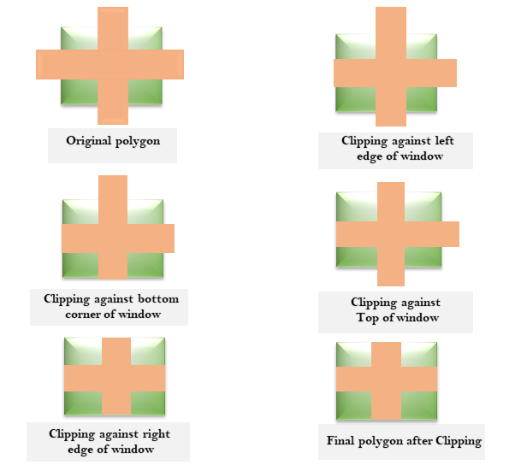
Sutherland-Hodgeman Polygon Clipping:
It is performed by processing the boundary of polygon against each window
corner or edge. First of all entire polygon is clipped against one edge, then resulting polygon is considered, then the polygon is considered against the second edge, so on for all four edges.
Four possible situations while processing
1. If the first vertex is an outside the window, the second vertex is inside the window. Then second vertex is added to the output list. The point of intersection of window boundary and polygon side (edge) is also added to the output line.
2. If both vertexes are inside window boundary.
Then only second vertex is added to the output list.
3. If the first vertex is inside the window and
second is an outside window. The edge which
intersects with window is added to output list.
4. If both vertices are the outside window, then
nothing is added to output list.
Following figures shows original polygon and
clipping of polygon against four windows.

Slide 29
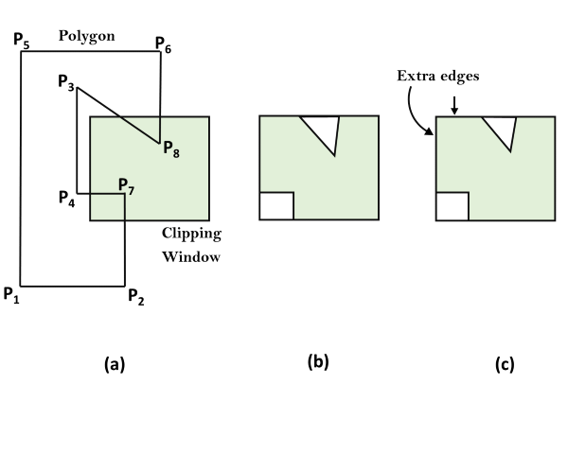
Weiler-Atherton Polygon Clipping:
When the clipped polygons have two or more separate sections, then it is the
concave polygon handled by this algorithm. The vertex-processing procedures for window boundaries are modified so that concave polygon is displayed.
Let the clipping window be initially called clip polygon and the polygon to be clipped the subject polygon. We start with an arbitrary vertex of the subject polygon and trace around its border in the clockwise direction until an intersection with the clip polygon is encountered:
1. If the edge enters the clip polygon, record the intersection point and continue to trace the subject polygon.
2. If the edge leaves the clip polygon, record the intersection point and make a right turn
to follow the clip polygon in the same manner (i.e., treat the clip polygon as subject
polygon and the subject polygon as clip polygon and proceed as before).

Slide 30
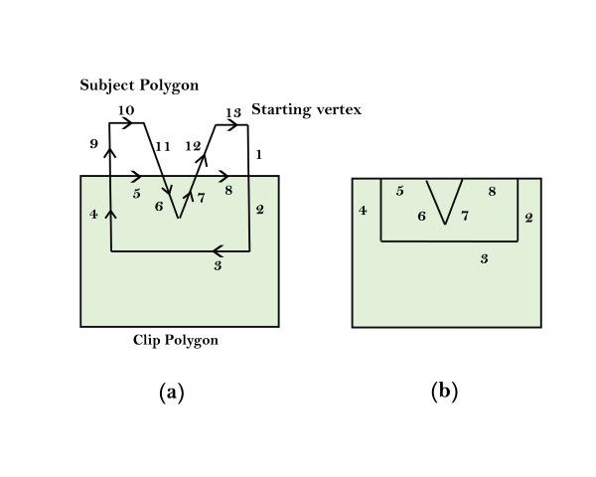
2. If the edge leaves the clip polygon, record the intersection point and make a right turn
to follow the clip polygon in the same manner (i.e., treat the clip polygon as subject
polygon and the subject polygon as clip polygon and proceed as before).
Whenever our path of traversal forms a sub-polygon we output the sub-polygon as part of the overall result. We then continue to trace the rest of the original subject polygon from a recorded intersection point that marks the beginning of a not-yet traced edge or portion of an edge. The algorithm terminates when the entire border of the original subject polygon has been traced exactly once.
For example, the number in fig (a) indicates the order in which the edges and portion of edges are traced. We begin at the starting vertex and continue along the same edge (from 1 to 2) of the subject polygon as it enters the clip polygon. As we move along the edge that is leaving the clip polygon, we make a right turn (from 4 to 5) onto the clip polygon, which is now considered the subject polygon. Following the same logic leads to the next right turn (from 5 to 6) onto the current clip polygon, this is the original subject polygon. With the next step done (from 7 to 8) in the same way, we have a sub-polygon for output in fig (b). We then resume our traversal of the original subject polygon from the recorded intersection point where we first changed our course. Going from 9 to 10 to 11 produces no output. After skipping the already traversed 6 and 7, we continue with 12 and 13 and come to an end. The fig (b) is the final result.

Slide 31

.

